Slide 1
INTRODUCTION
Name – sanket arun Kothawale
Roll no – 34343
Company – Maxgen technology pvt ltd
Location – KHARADI,pune - 411014
Company service – Maxgen technology is software company which provides services and work on Web develop,mobile app dev, full stack, data science machine learning And data analytics.

Slide 2
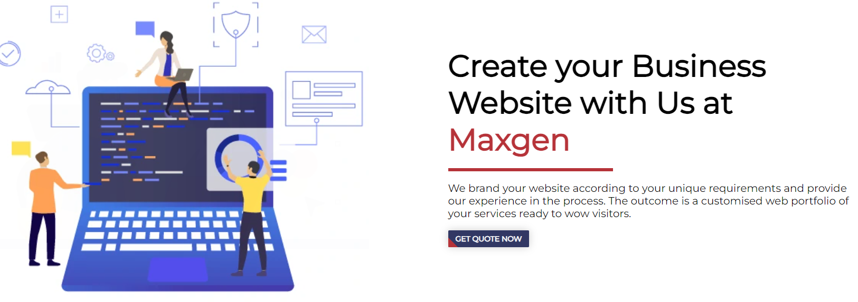
COMPANY PROFILE AND SERVICES

Slide 3
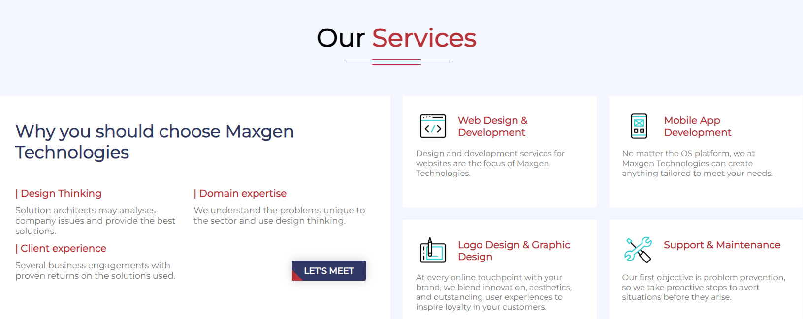
COMPANY SERVICES

Slide 4
WORK DONE IN COMPANY
1] Maxgen technology has provided a proper training and internship to me in data science using python.
2]A proper basic knowledge of python from crash was been given to me its types and then further study case and work with dataset has been done.
3] I have been working with various libraries like numpy, pandas, matplot, and seaborn for various data visualizations
4] A proper training and working was been done on various algorithnms in machine learning.

Slide 5
WORK DONE IN COMPANY
5] I have been trained and assign to work with various datasets and machine learning algorithms(supervise & unsupervised)
6] While work done on various data analysis ,graphs, charts,data preprocessing data visualization with the help of various libraries like matplot and seaborn.

Slide 6
PROJECT TOPIC INTRODUCTION
MEDICAL INSURANCE COST PRICE PREDICTION USING LINEAR REGRESSION MODEL
1] A Crucial component of the medical industry is medical insurance. On the other hand, it is challenging
2] To predict medical spending because most of the money comes from patients with rare conditions. Numerous ML Algorithnm and deep learning approaches are used for data predictions .the factors of training time and accuracy are looked at.
3] The bulk of machine learning algorithnm only require a brief time of training. However, the prediction results from these technique are not particularly accurate. Deep learning models can also find hidden patterns ,but their usage in real time is contrained by the training period.

Slide 7
ROLE IN PROJECT
1)In these project the main role was to checkout the dataset and apply various steps and preparing a clean dataset with zero duplicate values. For further data visualizations and data modelling, testing and training.
2) Below are few steps which plays a main role for our project for cost prediction.
i) Data Collection : - Describe how ,medical data is currently collected, including sources such as hospitals, clinics, insurance companies,etc.
ii)Data storage: Explain where and how the collected data is stored ,such as databases, spreadsheet,or other system

Slide 8
ROLE IN PROJECT
iii) Data Preprocessing: Detail any preprocessing steps currently undertaken including data cleaning, and feature engineering.
iv) Modelling Technique:- identify any existing modelling technique or algorithnm used for health cost prediction, if any
v) Performances Metrices:- Specify any performance metrices or evaluation methods currently employed to assess the accuracy and effectiveness of medical insurance cost prediction.

Slide 9
TECHNOLOGY USED IN PROJECT
There are several technologies used in data science project which are commonly used across different stages of the project, including data collection,pre processing, modelling,and deployement.
Here are some few technologies used
1]python libraries – (pandas, Numpy) for data manipulation and cleaning.
2] visualization tools – Matplotlib, seaborn for creating static and interactive plots.

Slide 10
TECHNOLOGY USED IN PROJECT
PLATFORM USED
1) JUPYTER NOTEBOOK - Jupyter Notebook is an interactive web-based environment that allows users to create and share documents containing live code, visualizations, and narrative text. Python IDLE, on the other hand, is a basic integrated development environment (IDE) that comes bundled with Python for writing and executing Python code.
2) GOOGLE COLAB - Colab is a hosted Jupyter Notebook service that requires no setup to use and provides free access to computing resources, including GPUs and TPUs. Colab is especially well suited to machine learning, data science, and education.

Slide 11
WHAT I HAVE LEARN FROM THESE SIX MONTH OF INTERNSHIP ??
I Have gained a confidence of working with the various datasets and working and applying various machine learning algorithnms on it.
I have gained a knowledge about all my basics of python from crash to ..how python code gets implemented in data science technology rather than only in web development.
I have learned new libraries like numpy pandas and how it works what are its roles while performing project.

Slide 12
WHAT I HAVE LEARNED FROM THESE SIX MONTHS OF INTERNSHIP ??
I Have learned a machine learning while how it plays a major role in data science and how it performs a major task of various algorithnms model its types and its role in every project
I have been worked and learn about various algorithnm models like linear regression, logistic regression, Decision tress, random forest classification, support vector machine, naïve bayes algorithnm , k- means clustering and k nearest neighbour.
I have learned how to train and test the data and show predictions accordingly while checking its accuracy score with different models and comparing it

Slide 13
EXISTING SYSTEM
1) Health Care insurance prediction using linear regression analysis: Linear regression is used to predict data. Linear regression is used for modelling the relationship between a scaler dependent variable y and one or more explanatory variables denoted x.
2) There are advances in these field , but the limitations remain the same. Simple linear regression is the one where only one explanatory variable are used.
Disadvantages of Existing system:-
1)Considers only two columns of the dataset for analysis.
2)The open value and close value are considered.
But the accuracy given is not satisfactory

Slide 14
REQUIREMENT
1] HARDWARE :-
The hardware and software used for a medical insurance prediction model in machine learning can vary depending on the scale of the project, the complexity of the model, and the specific requirements of the application. However, here are some commonly used hardware and software components:
1) System: AMD RYZEN 3rd gen 2.60 GHz
2) RAM: 8GB RAM
3) HARD DISK:- 256GB And MORE

Slide 15
REQUIREMENT
2] SOFTWARE :-
1) Operating System :- Windows 11
2)Language Used :- Python
3) LIBRARIES :- Pandas,Numpy,Matplotlib,Seaborn.
4) Jupyter Notebook / Google Colab.

Slide 16
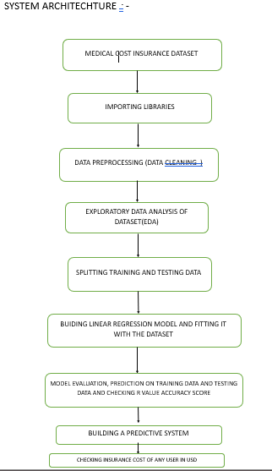
FLOWCHART

Slide 17
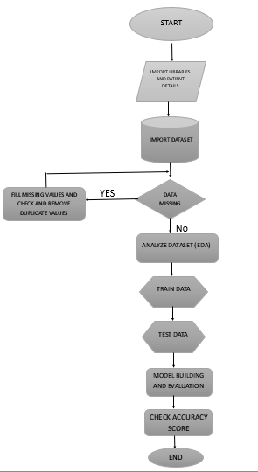
FLOWCHART

Slide 18
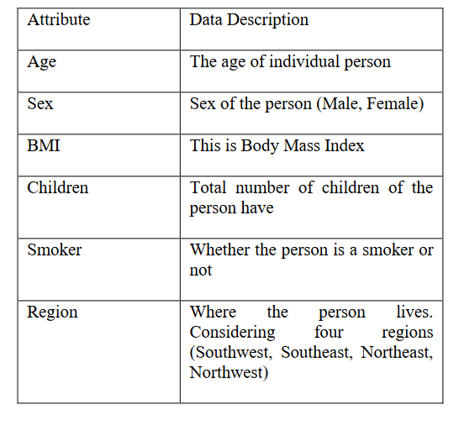
I/O SCREEN WITH REPORT
The data set is split into two categories: training data and test data, The table below contains the dataset description
Overview of Dataset:-

Slide 19
I/O INPUT SCREEN
There were 1338 rows and 7 columns in our data set. The charges variable, which has a float value, is our aim. Maximum number of individuals in our dataset range in age from 18 to 22.5, and the majority of them are male. Few have more than three children, and the majority of them have a BMI between 29.26 and 31.16. In this dataset, four main regions are taken into account: northeast, northwest, southeast, and southwest. The largest concentration of smokers is in the southeast, where 1064 out of 1338 people smoke. We'll investigate our information to determine how the various factors are related. Our target column in this instance is "charges," which is dependent upon every other column. We shall first examine our dataset's statistical

Slide 20
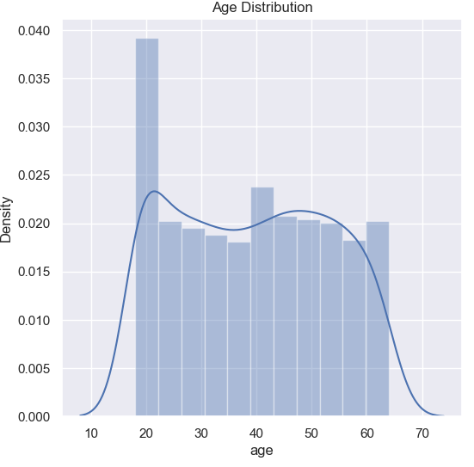
I/O INPUT SCREEN
DATA VISUALIZATION GRAPHS

Slide 21
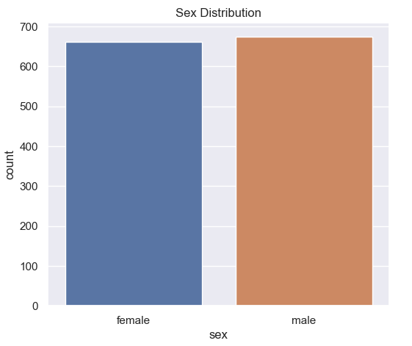
I/O INPUT SCREEN
SEX DISTRIBUTION

Slide 22
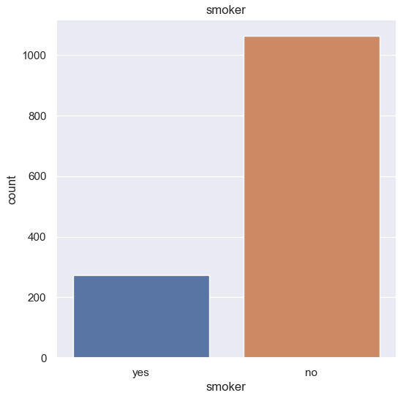
I/O INPUT SCREEN
SMOKER NON SMOKER
COUNT

Slide 23
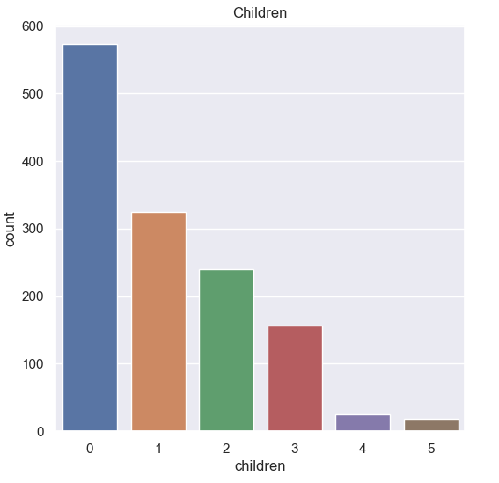
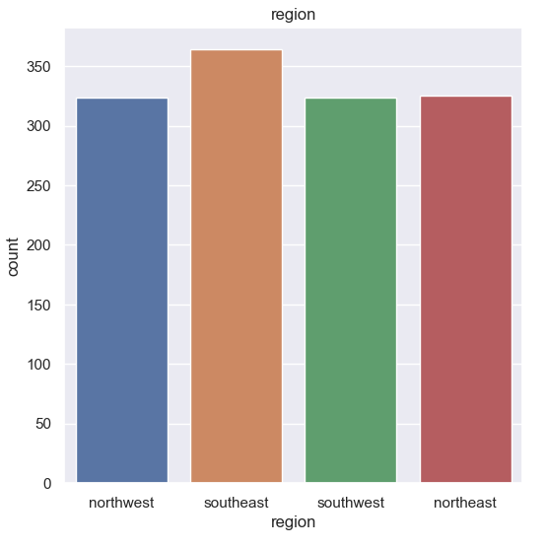
I/O INPUT SCREEN
CHILDREN COUNT
REGION COUNT

Slide 24
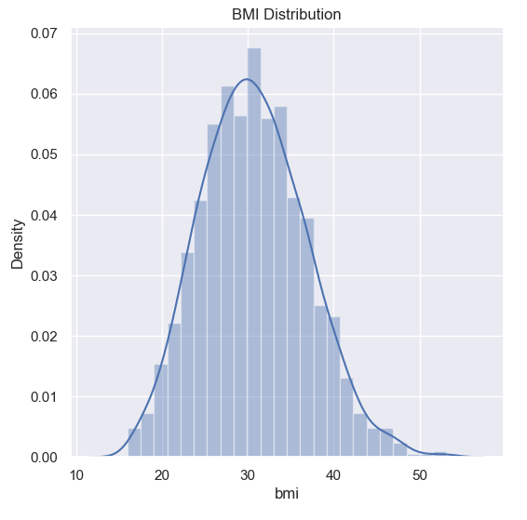
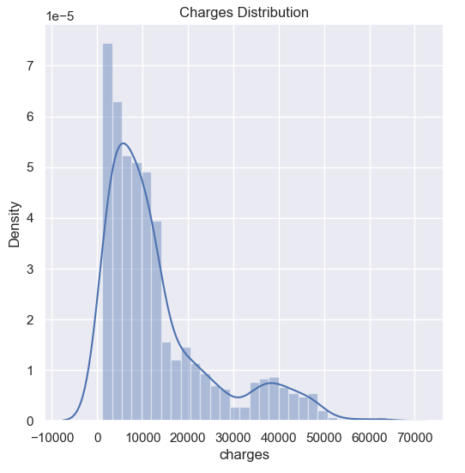
I/O INPUT SCREEN
BMI DISTRIBUTION
CHARGES DISTRIBUTION

Slide 25
I/O INPUT SCREEN
DATA PREPROCESSING
Three columns are numerical and three are categorical. Our machine learning model cannot suit the category values because computers cannot understand this text value. Therefore, we will give those categories qualities numerical labels. We change "female" to 1 and "male" to 0 in the "sex" field. We also change the other two columns to have numerical values. We display our results for conversion in the table below.

Slide 26
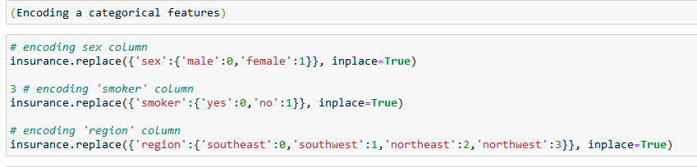
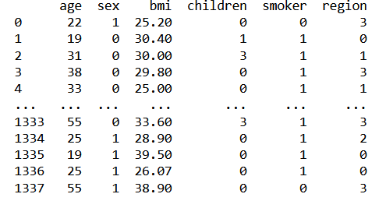
I/O INPUT SCREEN

Slide 27
I/O INPUT SCREEN
MODEL SPECIFICATION
The goal of the study is to forecast insurance costs based on a variety of factors, including age, sex, the number of children, location, BMI, and whether or not a person smokes. All of these characteristics aid in our ability to calculate the price of health insurance. Several regression models are used in this study to calculate the cost of health insurance. There are two portions to the data. Model testing is done in the other
portion, whereas model training is done in the first. Data is used for training 80% of the time and testing 20%. We compute the R-squared value (RE), and Mean Squared Error (MSE) for each model to see how accurate it is in predicting costs.

Slide 28
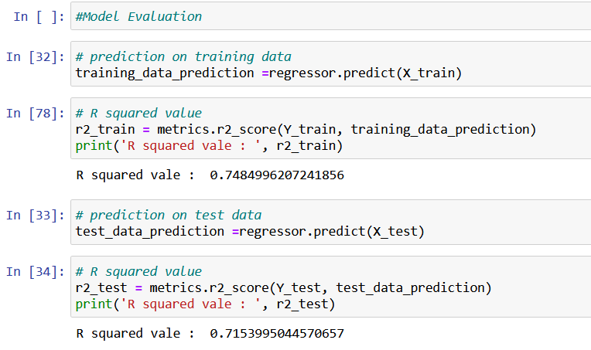
I/O INPUT SCREEN

Slide 29
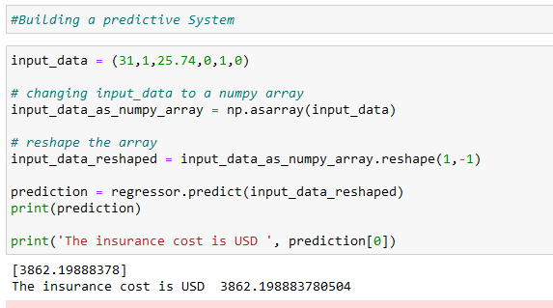
I/O OUTPUT SCREEN
RESULT AND PREDICTIVE SYSTEM:-
we can see how medical insurance cost prediction system predict the cost for LR,

Slide 30
CHALLENGES I FACED DURING INTERNSHIP
During my ongoing internship I was faced through some few challenges task during implementation of my project, like while prediction training and testing of data then predicting its value under various algorithms models.
It was challenging while comparing its r value accuracy score under comparison of other models.while predicting the accuracy score was not very at that accurate which would be drawback point of these project.
I have to work on various mini project of each and every model on machine learning while learning every new algorithnm.(eg. Creating every mini project for each model for linear regression,decision tress,random forest,kmeans,knn etc)

Slide 31
LIMITATION & DRAWBACKS
One of the biggest disadvantages in medical insurance is pre-existing exclusions where the customers have to undergo a certain waiting period for certain ailments. Most of the insurance companies have a bigger co-pay for senior citizens and they also end up paying higher premium for their policies.
One of the challenges in the insurance claim process has to do with claim settlement i.e. late settlement or repudiation by the insurer. This leads to bad customer experiences and in the long run loss of business when the customer takes his or her business to a competitor.

Slide 32
REFERENCES
[1] "Digital Health 150: The Digital Health Startups Transforming the Future of Healthcare | CB Insights
Research", CB Insights Research, 2022. [Online].Available: https://www.cbinsights.com/research/report/digital-
health-startups-redefining-healthcare. [Accessed: 10-Sep- 2022]
[2] J. H. Lee, “Pricing and reimbursement pathways of new ophan drugs in South Korea: A longitudinal comparison.
in healthcare,” Multidisciplinary Digital Publishing Institute, vol. 9, no. 3, pp. 296, 2021.
[3] Gupta, S., & Tripathi, P. (2016, February). An emerging trend of big data analytics with health insurance in India.
In 2016 International Conference on Innovation and Challenges in Cyber Security (ICICCS-INBUSH) (pp.
64-69). IEEE

Slide 33
CONCLUSION
In the field of health insurance, machine learning is well-suited to tasks that are.often
performed by people at a slower speed. AI and machine learning can analyze and evaluating large volumes of data in order to streamline and simplify health insurance operations. The impactof machine learning on health insurance will save time and money for both policyholders and insurers.
In order to forecast medical health insurance prices based on factors medical cost individual data set, the study combines ML regression models. By predicting insurance rates based on a variety of factors, insurance policy firms may attract consumers and save time. Machine learning may significantly reduce these individual efforts in price analysis since ML models can compute costs quickly while doing sowould take a person a long time. Large volumes of data can also be handled via machine learning techniques

